Slide 1
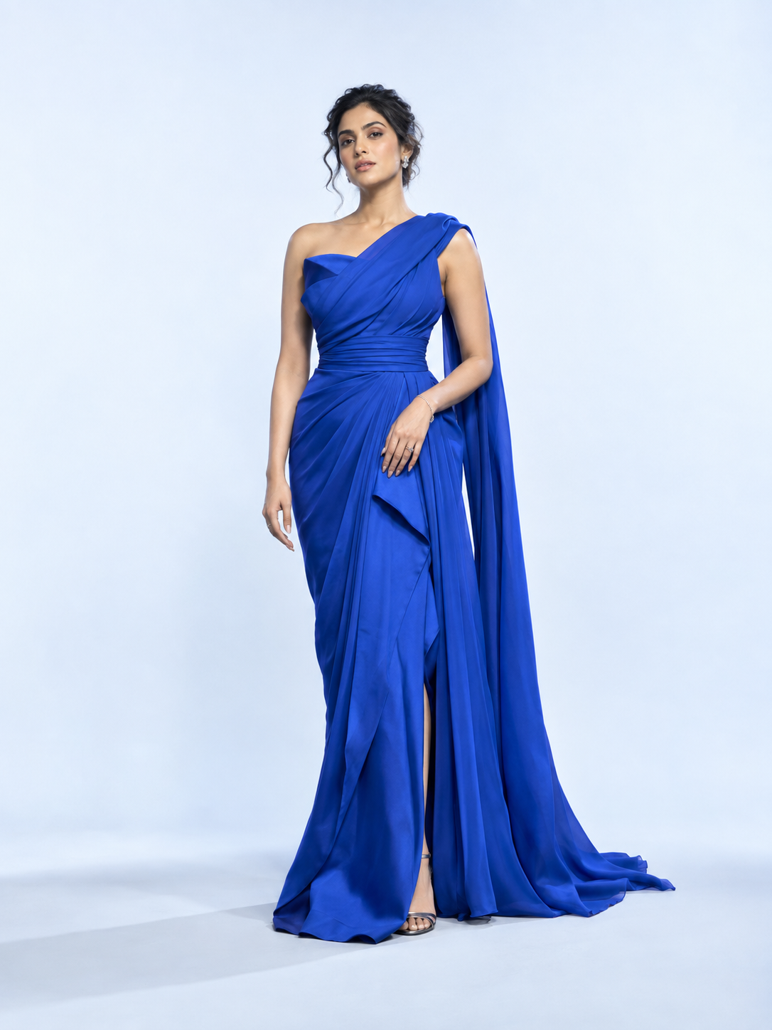
MyTryOnStudio
See your
next look.
Personal try-on. Shared possibilities.
A more personal way to discover fashion.
Notes:
Product basis: https://github.com/jana247/OnlineShopping/tree/712450a5c3e6880217f31f6b76eccee0571d358c ; reviewed main-branch implementation, not live production testing. See accompanying competitive review for detailed code evidence. Benefits are intended outcomes, not measured results. Cover image is AI-created illustrative campaign imagery, not a MyTryOnStudio output. No evidence of physical fit is implied.

Slide 2
Help shoppers picture the possibility.
Move from an outfit on a product page to a look that feels personal.
01 / Personal
02 / Creative
03 / Memorable
See it on yourself
Explore the look
Keep the inspiration
Use a shopper’s photo to make exploration more personal.
Create pose variations and motion from a generated result.
Save photos, revisit history, and download favourite results.
MyTryOnStudio
02
Notes:
Product basis: https://github.com/jana247/OnlineShopping/tree/712450a5c3e6880217f31f6b76eccee0571d358c ; reviewed main-branch implementation, not live production testing. See accompanying competitive review for detailed code evidence. Benefits are intended outcomes, not measured results.

Slide 3
A simple path into the studio.
01
02
03
Choose a look
Add your photo
Create & explore
Start with a product
from the catalog.
Upload a photo or
reuse a saved one.
Generate a try-on, then
explore poses or video.
Visual styling, not a size or physical-fit prediction.
MyTryOnStudio
03
Notes:
Product basis: https://github.com/jana247/OnlineShopping/tree/712450a5c3e6880217f31f6b76eccee0571d358c ; reviewed main-branch implementation, not live production testing. See accompanying competitive review for detailed code evidence. Benefits are intended outcomes, not measured results.

Slide 4

Two people.
One beautiful
possibility.
The couples studio
Combine two partners’ looks in a shared composition. Explore coordinated style for celebrations and special moments.
Illustrative campaign imagery
Notes:
Product basis: https://github.com/jana247/OnlineShopping/tree/712450a5c3e6880217f31f6b76eccee0571d358c ; reviewed main-branch implementation, not live production testing. See accompanying competitive review for detailed code evidence. Benefits are intended outcomes, not measured results. AI-created campaign image, not an actual couples composition output. Couples workflow is implemented: two product/photo choices or previous generations, composition, poses, transition video.

Slide 5
A look is just the beginning.
01
A fresh perspective
Standing and walking pose variations offer new ways to explore a look.
02
From still to motion
Image-to-video generation brings a result into motion.
03
A shared moment
Couples can explore a transition between generated frames.
MyTryOnStudio
05
Notes:
Product basis: https://github.com/jana247/OnlineShopping/tree/712450a5c3e6880217f31f6b76eccee0571d358c ; reviewed main-branch implementation, not live production testing. See accompanying competitive review for detailed code evidence. Benefits are intended outcomes, not measured results.

Slide 6
Keep the journey connected.
A personal studio experience supported by discovery and continuity.
Discover
Revisit
Take away
Find a promising piece
Return to your style
Keep your favourites
Catalog search, wishlists, and an assistant with stock checks.
Saved input photos and a history of generated results.
View results up close and download them for later.
MyTryOnStudio
06
Notes:
Product basis: https://github.com/jana247/OnlineShopping/tree/712450a5c3e6880217f31f6b76eccee0571d358c ; reviewed main-branch implementation, not live production testing. See accompanying competitive review for detailed code evidence. Benefits are intended outcomes, not measured results.

Slide 7
A creative experience.
An operational foundation.
Catalog management
Credits & quotas
Manage products and organise the collection.
Control generation access and usage allowances.
Studio reporting
Retailer flexibility
Review studio usage alongside admin reporting.
Tenant foundations and configurable service credentials.
Deployment scope and service configuration are agreed during the pilot.
MyTryOnStudio
07
Notes:
Product basis: https://github.com/jana247/OnlineShopping/tree/712450a5c3e6880217f31f6b76eccee0571d358c ; reviewed main-branch implementation, not live production testing. See accompanying competitive review for detailed code evidence. Benefits are intended outcomes, not measured results.

Slide 8

In-store digital standee
A new look, right in your store
Choose a dress
Select a look from the store collection.
Stand in front & take a photo
Capture a photo using the standee camera.
See the new look
The screen shows the customer in their chosen dress.
Illustrative concept · Store installation and hardware agreed per deployment
Notes:
Product basis: https://github.com/jana247/OnlineShopping/tree/712450a5c3e6880217f31f6b76eccee0571d358c ; reviewed main-branch implementation, not live production testing. See accompanying competitive review for detailed code evidence. Benefits are intended outcomes, not measured results. Retailer digital standee installation offering supplied by the product owner. AI-created concept illustration: the same woman beside the standee in an ivory blouse and navy trousers, and on the display in a blue saree. This is not documentary evidence of an operating installation or a MyTryOnStudio output. Hardware, camera, catalog connection, and setup are agreed per store.

Slide 9
Choose the moment that matters.
Three focused ways to introduce MyTryOnStudio.
Occasion wear
Couples collections
Everyday discovery
Picture the celebration
Find a shared style
Discover a favourite
Explore wedding, festival, and special-event pieces in a personal way.
Bring complementary outfit choices into one creative composition.
Turn catalog browsing into a repeatable journey of exploration.
MyTryOnStudio
09
Notes:
Product basis: https://github.com/jana247/OnlineShopping/tree/712450a5c3e6880217f31f6b76eccee0571d358c ; reviewed main-branch implementation, not live production testing. See accompanying competitive review for detailed code evidence. Benefits are intended outcomes, not measured results.

Slide 10
Start focused. Learn from real shoppers.
A proposed pilot—not a promised performance uplift.
01
02
03
04
Curate
Experience
Evaluate
Expand
Choose a small collection and representative shopper photos.
Walk through personal try-on, couples, poses, and downloads.
Review quality, completion, repeat use, and generation cost.
Prioritise changes from evidence before a wider rollout.
MyTryOnStudio
10
Notes:
Product basis: https://github.com/jana247/OnlineShopping/tree/712450a5c3e6880217f31f6b76eccee0571d358c ; reviewed main-branch implementation, not live production testing. See accompanying competitive review for detailed code evidence. Benefits are intended outcomes, not measured results.

Slide 11
Where the experience can go next.
Future opportunities to prioritise together. Not current feature commitments.
Make it easier
Make it scalable
Make it measurable
Closer to the product
Ready for more volume
Learn what works
Embedded shopping journeys, selected-variant accuracy, and guided photo capture.
Durable generation jobs, batch workflows, and operational reliability.
Clear retention controls and deeper engagement and conversion attribution.
MyTryOnStudio
11
Notes:
Product basis: https://github.com/jana247/OnlineShopping/tree/712450a5c3e6880217f31f6b76eccee0571d358c ; reviewed main-branch implementation, not live production testing. See accompanying competitive review for detailed code evidence. Benefits are intended outcomes, not measured results. Future opportunities inferred from competitor research, not available product promises. Sources: https://www.tryoncloud.com/features ; https://www.aiuta.com/ ; https://www.veesual.ai/solutions/e-commerce ; https://www.mentishq.com/ . These inform strategic priorities; no competitor outcome statistics are used.

Slide 12
MyTryOnStudio
Your collection.
Your next chapter.
Let’s build a more personal
way to discover fashion.
Explore mytryonstudio.com
Notes:
Product basis: https://github.com/jana247/OnlineShopping/tree/712450a5c3e6880217f31f6b76eccee0571d358c ; reviewed main-branch implementation, not live production testing. See accompanying competitive review for detailed code evidence. Benefits are intended outcomes, not measured results.

